Slide 1

BPNet and Its Application
Liu Chao

Slide 2

目录
1. BPNet
2. Code
3. Application
4. Summary

Slide 3
目录
1. BPNet
1.1 Traditional Classification Method
1.2 Neural Network
1.3 Loss Function
1.4 The Gradient Descend Method

Slide 4
目录
1. BPNet
1.1 Traditional Classification Method
1.2 Neural Network
1.3 Loss Function
1.4 The Gradient Descend Method

Slide 5







1.1 How did we do classification in a traditional way?
$$x_{2}$$
Logistic regression
$$y=f\left(x,w,b\right)=\frac{1}{1+e^{−(wx+b)}}$$
Linear function
$$y=wx+b$$
$$w=[w_{1},w_{2}]$$
$$x=[x_{1},x_{2}]′$$
Sigmoid function
$$x_{1}$$
$$f\left(x\right)=\frac{1}{1+e^{−x}}$$
Result
y>0.5
y<0.5

Slide 6




1.1 How did we do classification in a traditional way?
$$y=f\left(x\right)=\frac{1}{1+e^{−(wx+b)}}$$
Loss function
$$L=\min_{w,b}{{\frac{1}{2}(y−y^{′})}^{2}}$$
Gradient descend
Random
Initialization
$w=w−μ\frac{∂L}{∂w},$ $b=b−μ\frac{∂L}{∂b}$
$\frac{∂L}{∂w}=y\left(1−y\right)x$, $\frac{∂L}{∂b}=y\left(1−y\right)$

Slide 7
1.1 Why do we need neural network?
We need an excellent non-linear function!

Slide 8
目录
1. BPNet
1.1 Traditional Classification Method
1.2 Neural Network
1.3 Loss Function
1.4 The Gradient Descend Method

Slide 9


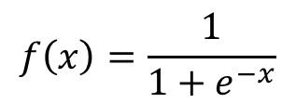
















1.2 What is the neural network?
$$w_{11}$$
$$x_{1}$$
$$w_{11}$$
$$w_{12}$$
$$w_{13}$$
$$w_{21}$$
$$y$$
$$w_{21}$$
$$x_{2}$$
$$w_{22}$$
$$w_{33}$$
$$w_{22}$$
$$b_{1}$$
$$b_{1}$$
$$b_{2}$$
Input Layer
$$b_{3}$$
Hidden Layer
Output Layer
$$f\left(W_{1}x+b_{1}\right)$$
$$f\left(x\right)=\frac{1}{1+e^{−x}}$$
$$y=f(W_{2}$$
$$+b_{2})$$

Slide 10






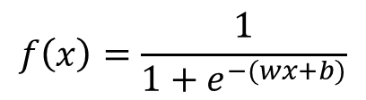


1.2 Neural network without hidden layers
$$x_{2}$$
$$x_{1}$$
$$w_{1}$$
$$y$$
$$x_{2}$$
$$w_{2}$$
b
$$x_{1}$$
Traditional Logistic Regression
$$y=f(wx+b)$$
$$f\left(x\right)=\frac{1}{1+e^{−(wx+b)}}$$

Slide 11








1.2 Neural network with one hidden layer
$$w_{1}$$
$$x_{1}$$
$$w_{1}$$
$$y$$
$$w_{2}$$
$$x_{2}$$
$$b$$
$$b$$
$$y=f(W_{2}f\left(W_{1}x+b_{1}\right)+b_{2})$$

Slide 12



1.2 Neural network with one hidden layer
$$x_{1}$$
$$y$$
$$x_{2}$$
$$y=f(W_{2}f\left(W_{1}x+b_{1}\right)+b_{2})$$

Slide 13
1.2 Neural network with more complex structure
Neural network is an excellent non-linear function.
The non-linear function is a composition of many linear functions.

Slide 14
目录
1. BPNet
1.1 Traditional Classification Method
1.2 Neural Network
1.3 Loss Function
1.4 The Gradient Descend Method

Slide 15


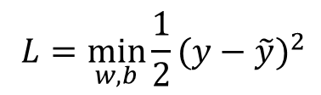
1.3 Why should the loss function be convex?
$$L=\min_{w,b}{{\frac{1}{2}(y−\tilde{y})}^{2}}$$
$$L(x)$$
$$x$$

Slide 16
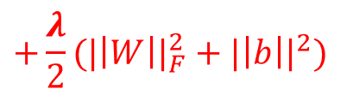
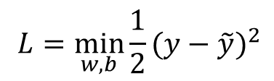
1.3 Why to use the regularization terms?
$$L=\min_{w,b}{{\frac{1}{2}(y−\tilde{y})}^{2}}$$
$$+\frac{λ}{2}({|\left|W\right||}_{F}^{2}+{|\left|b\right||}^{2})$$

Slide 17
目录
1. BPNet
1.1 Traditional Classification Method
1.2 Neural Network
1.3 Loss Function
1.4 The Gradient Descend Method

Slide 18










1.3 How to apply the gradient descent to the BPNet?
$$L=\min_{w,b}{{\frac{1}{2}(y−\tilde{y})}^{2}}+\frac{λ}{2}({|\left|W\right||}_{F}^{2}+{|\left|b\right||}^{2})$$
$$y=f_{2}(W_{2}f_{1}\left(W_{1}x+b_{1}\right)+b_{2})$$
$$y=f_{2}(W_{2}f_{1}\left(W_{1}h_{1}+b_{1}\right)+b_{2})$$
$$y=f_{2}(W_{2}h_{2}+b_{2})$$
$$\frac{∂L}{∂W_{1}}=(y−\tilde{y})f_{2}^{′}W_{2}f_{1}^{′}h_{1}+λW_{1}$$
$$\frac{∂L}{∂W_{2}}=$$
$$(y−\tilde{y})$$
$$f_{2}^{′}$$
$$+λW_{2}$$
$$h_{2}$$
$$\frac{∂L}{∂b_{1}}=(y−\tilde{y})f_{2}^{′}W_{2}f_{1}^{′}+λb_{1}$$
$$\frac{∂L}{∂b_{2}}=(y−\tilde{y})f_{2}^{′}+λb_{2}$$

Slide 19



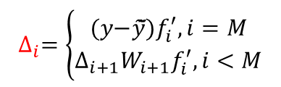







1.3 How to apply the gradient descent to the BPNet?
$$\frac{∂L}{∂W_{2}}=(y−\tilde{y})f_{2}^{′}h_{2}+λW_{2}$$
$$\frac{∂L}{∂b_{2}}=(y−\tilde{y})f_{2}^{′}+λb_{1}$$
$$\frac{∂L}{∂W_{1}}=(y−\tilde{y})f_{2}^{′}W_{2}f_{1}^{′}h_{1}+λW_{1}$$
$$\frac{∂L}{∂b_{1}}=(y−\tilde{y})f_{2}^{′}W_{2}f_{1}^{′}+λb_{2}$$
$$\frac{∂L}{∂W_{i}}=$$
$$∆_{i}=\left\{\begin{aligned}\text{(}\text{y}\text{−}\tilde{y}\text{̃}\text{)}f_{i}^{′},i=M \\ ∆_{i+1}W_{i+1}f_{i}^{′}, i<M\end{aligned}\right.$$
$$∆_{i}$$
$$h_{i}+λW_{i}$$
$$\frac{∂L}{∂b_{i}}=$$
$$∆_{i}$$
$$+λb_{i}$$

Slide 20
目录
1. BPNet
2. Code
3. Application
4. Summary

Slide 21










2.1 Workflow
$W_{i}=W_{i}−μ\frac{∂L}{∂W_{i}}$
$$\frac{∂L}{∂W_{i}}$$
$$\frac{∂L}{∂b_{i}}$$
$$b_{i}=b_{i}−μ\frac{∂L}{∂b_{i}}$$
$$W_{i},b_{i},…$$
$$y=f(x)$$
0. Network
Initialization
1. Forward
Propagation
2. Compute
Gradient
3. Back
Propagation
$$No$$
$$Yes$$
5. Stopping Condition
4. Evaluate
Loss Function
$$\left|L_{t}−L_{t−1}\right|<ε,t>T$$
$$L_{t}$$

Slide 22









2.2 Network Initialization
Network structure
$node=\left[2,3,1\right]$;
$M=2$;
Data recorded in each layers
$$layer=\text{cell}\text{(}\text{M}\text{+1);}$$
$$layer\left\{i\right\}=zeros\left(node\left(i\right)\right);$$
$$layer\left\{1\right\}={\left[x_{1},x_{2}\right]}^{′};$$
Weights
$$W=\text{cell}\text{(}\text{M}\text{)}\text{;}$$
$$W\{i\}=randn\text{(}\text{node}\text{(}\text{i}\text{+1), }\text{node}\text{(}\text{i}\text{));}$$
Biases
$$b=\text{cell}\text{(}\text{M}\text{)}\text{;}$$
$$b\left\{i\right\}=0;$$

Slide 23
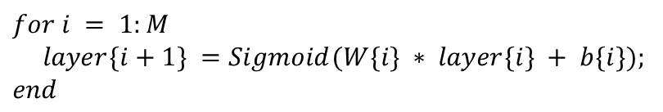



2.3 Forward Propagation
$$y_{1}=f\left(W_{1}x+b_{1}\right)$$
$$for i = 1:M$$
$$layer\{i+1\} =Sigmoid(W\{i\} ∗ layer\{i\} + b\{i\});$$
$$end$$
$$y_{i+1}=f (W_{i+1}y_{i}+b_{i+1})$$
$$…$$

Slide 24


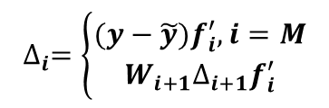








2.4 Compute Gradient
$$for i = M:−1:1$$
$$\frac{∂L}{∂W_{i}}=∆_{i}x_{i}+λW_{i}$$
$$if i=M$$
$$delta\{i\} =(layer\left\{M+1\right\}−Label);$$
$$\frac{∂L}{∂b_{i}}=∆_{i}+λb_{i}$$
$$else$$
$$delta\{i\} = W\{i+1\}’∗delta\{i+1\}.∗deSigmoid(layer\{i\});$$
$$end$$
$$∆_{i}=\left\{\begin{aligned}(y−\tilde{y})f_{i}^{′},i=M \\ W_{i+1}∆_{i+1}f_{i}^{′}\end{aligned}\right.$$
$$\text{dLW}\text{\{}\text{i}\text{\} = }\text{delta}\text{\{}\text{i}\text{\}∗}\text{l}\text{ayer}\text{\{}\text{i}\text{\} +}λ\text{∗}\text{b}\text{\{}\text{i}\text{\};}$$
$$\text{dLb}\text{\{}\text{i}\text{\} = }\text{delta}\text{\{}\text{i}\text{\} +}λ\text{∗}\text{b}\text{\{}\text{i}\text{\};}$$
$$end$$

Slide 25





2.5 Back Propagation
$W_{i}=W_{i}−μ\frac{∂L}{∂W_{i}}$
$$for\text{i}\text{ = }\text{1}\text{:}\text{M}$$
$$b_{i}=b_{i}−μ\frac{∂L}{∂b_{i}}$$
$W\{i\} = W\{i\} – step ∗ dLW\{i\};$
$b\{i\} = b\{i\} – step ∗ dLb\{i\};$
$$end$$

Slide 26




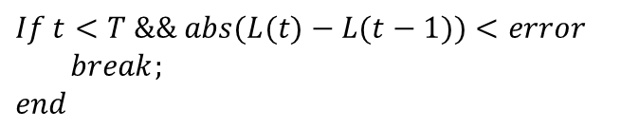
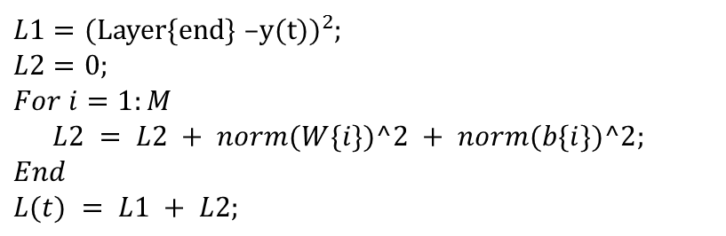
2.6 Evaluation and Stopping Condition
Evaluation via loss function
$$L=L_{1}+L_{2}$$
Stopping Condition
$$=\min_{w,b}{{\frac{1}{2}(y−\tilde{y})}^{2}}+\frac{λ}{2}({|\left|W\right||}_{F}^{2}+{|\left|b\right||}^{2})$$
$$\left|L_{t}−L_{t−1}\right|<ε,t>T$$
$L1={\text{(}\text{Layer}\text{\{}\text{end}\text{\} }\text{–}\text{y}\text{(}\text{t}\text{))}}^{2}$;
$$L2=0;$$
$$For i=1:M$$
$L2 = L2 + norm(W\{i\})^2 + norm(b\{i\})^2;$
$$End$$
$$L(t) = L1 + L2;$$
$$If t<T \&\& abs(L(t)−L(t−1))<error$$
$break;$
$$end$$

Slide 27
目录
1. BPNet
2. Code
3. Application
4. Summary

Slide 28


Learning to Rank
30 graduate students in a class
The salary rank in the first year after graduation?
GPA
Total Scholarship Amount
…
Salary
Rank
2006
2007
2008
2009
2010
2011
2012
2013
2014
2015
2016
2017?

Slide 29



3.2 Pointwise approach
GPA
Scholarship
Salary
$$Salary$$
3.8
￥30,000
￥10,000/Month
Student 1
10 years’ records of all the students
3.2
￥3,000
￥8,000/Month
…
3.0
￥0
￥6,000/Month
Student n
$$GPA$$
$$L=\min_{W,b}{\frac{1}{2}{(f\left(x\right)−Salary)}^{2}}+\frac{1}{2}({||W||}_{F}^{2}+{||b||}^{2})$$

Slide 30







3.2 Listwise approach
2016
Student 1
Student 2
Student 3
Student 4
Student 5
Predicted Salary
$$f\left(x_{1}\right)$$
$$f\left(x_{2}\right)$$
$$f\left(x_{3}\right)$$
$$f\left(x_{4}\right)$$
$$f\left(x_{5}\right)$$
$$f(X)$$
Real Rank
3
1
5
4
2
R
$$L=\min_{W,b}{\frac{1}{2}(1−\frac{{f(X)}^{T}R}{\left\|f\left(X\right)\right\|\left\|R\right\|})}+\frac{1}{2}({||W||}_{F}^{2}+{||b||}^{2})$$

Slide 31
目录
1. BPNet
2. Code
3. Application
4. Summary

Slide 32




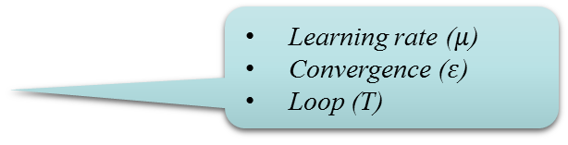
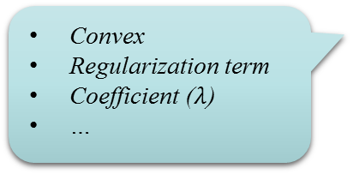
4. Summary
$$y=f(x)$$
Research Question
BPNet
Non-linear
Network structure
Activation function
Convex
Regularization term
Coefficient ($λ$)
…
Loss Function
Neural Network
Learning rate ($μ$)
Convergence ($ε$)
Loop (T)
Gradient Descend

Slide 33
Thanks!

